Slide 1








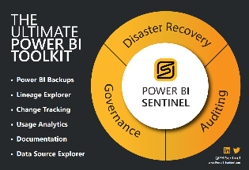
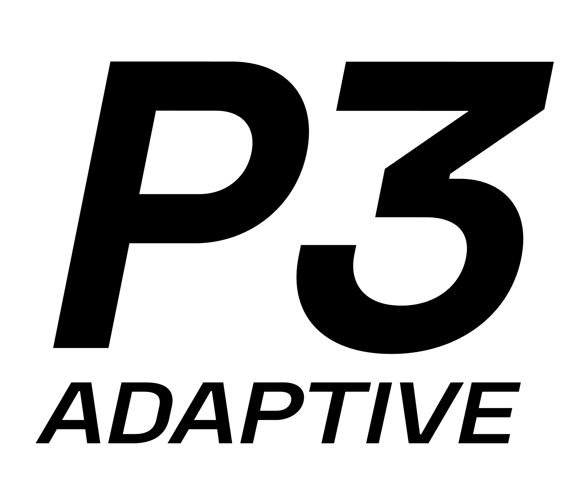

SQL Saturday Atlanta – 2023 Sponsors
Please do not forget to visit our Sponsors table and thank them.

Slide 2



Azure Data Factory
Metadata-driven ETL Patterns
Mike Diehl, Miked@imaginet.Com
Practice Lead
Data Engineering and Business Intelligence
@xhead
/mikediehlsqlbi

Slide 3

ABOUT IMAGINET
25+
Years in Business
Professional services company providing custom software solutions to organizations across North America. Founded in 1997 Located in Dallas, TX and Winnipeg, MB with 100 full-time employees across US & Canada (developers, QA, UX, Cloud Architecture, Microsoft 365, project managers).
20-Time Microsoft Gold Partner Core specialties: Data and Analytics, Power Platform, SharePoint, Teams 10+ years experience with Microsoft 365.
20x
Microsoft Gold Partner
1,400+
Satisfied Customers
3,200+
Successful Engagements

Slide 4
Abstract
Do you have dozens or even hundreds of datasets and tasks in your pipelines in Azure Data Factory (ADF)? Especially if you've developed SSIS packages and now you're trying Azure Data Factory, you will likely benefit from using a metadata-driven approach, which can save you significant ETL development effort and drastically reduce the complexity of your Azure Data Factories. This session shows how to build pipelines in Azure Data Factory that are driven by data in a table. Using these patterns, your ETL development velocity can be significantly increased. Once you've built a pipeline to handle one table load, you can easily load dozens or hundreds of tables in your pipeline just by updating the metadata in one table. I'll show you the patterns I use for managing dependencies (load these tables before those tables), incremental loading (load only the data that has changed since the last time this executed), and how to parameterize various options. If you learn these patterns and implement them yourself, you can spend far less time coding ETL processes and increase your productivity greatly.

Slide 5
Why use metadata for Azure Data Factory?
Reduces ETL development, increases velocity
Compared to….SSIS
Code and slides:
https://github.com/xhead/SqlSaturdayATL

Slide 6
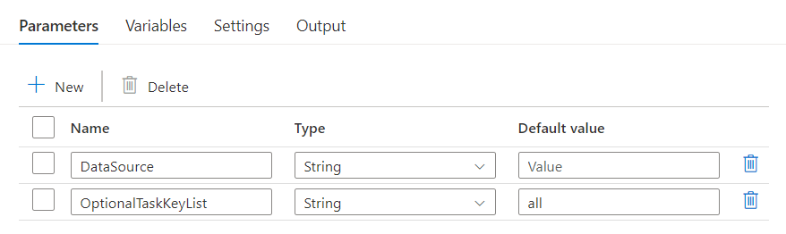
Azure Data Factory features
Parameters

Slide 7
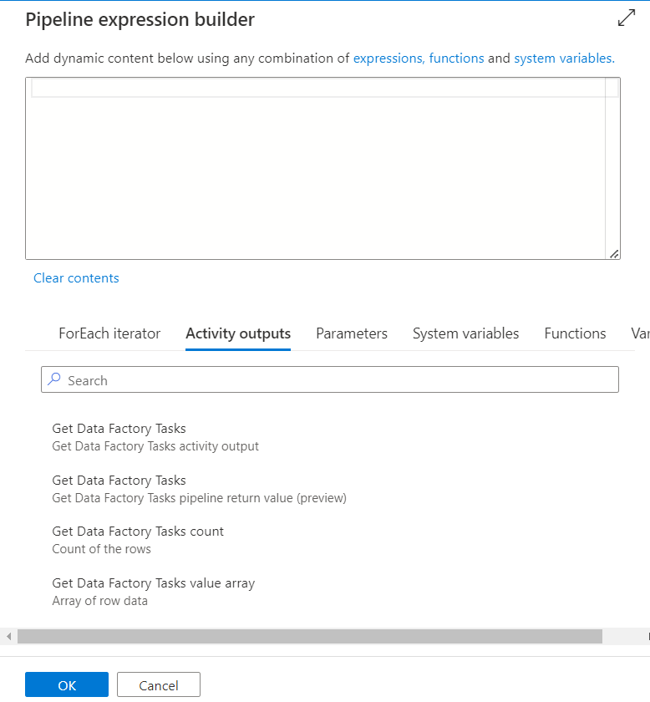

Azure Data Factory features
Dynamic content

Slide 8
Scenario: Metadata-driven Approach
Target: Data mart/warehouse
Target knows what it needs to get and when it last got it
Set of tasks:
Get data from source, store it in staging area, merge it into target
Dependencies
Load dimensions first, then facts that depend on dimensions
Develop ADF at the Data Source type level
SQL server, Oracle server, plus authentication type
File source (File System, SharePoint, Azure) and type (XML, JSON, CSV)

Slide 9
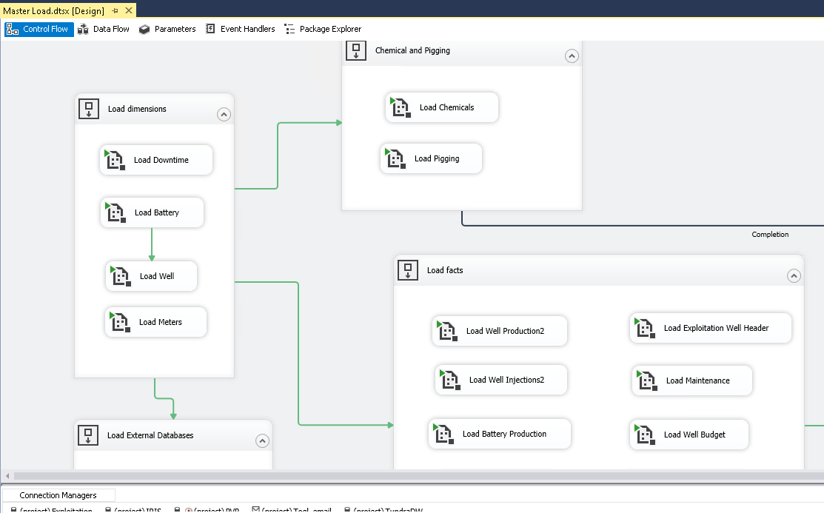
SSIS Approach
Develop at the COLUMN level
Column changes require updating of mappings in Data flow tasks
Redeploy updated SSIS packages

Slide 10
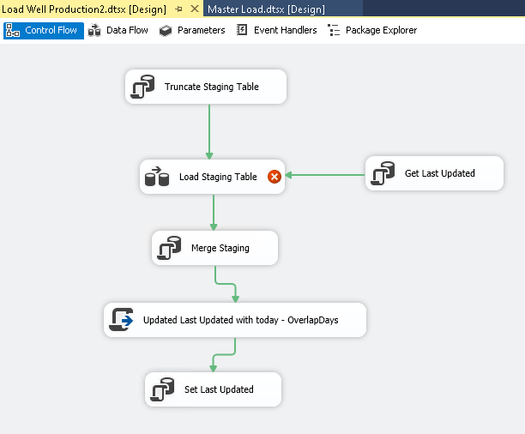
SSIS Approach
Develop at the COLUMN level
Column changes require updating of mappings in Data flow tasks
Redeploy updated SSIS packages

Slide 11
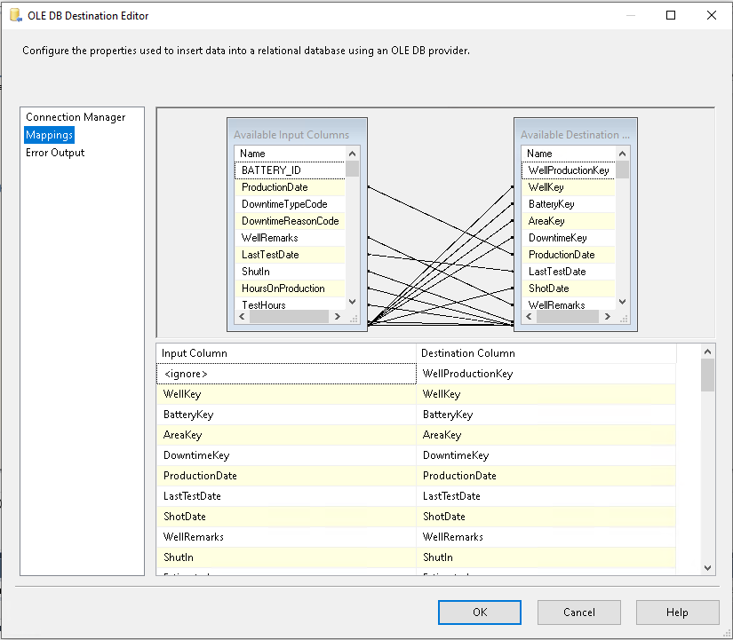
SSIS Approach
Develop at the COLUMN level
Column changes require updating of mappings in Data flow tasks
Redeploy updated SSIS packages

Slide 12
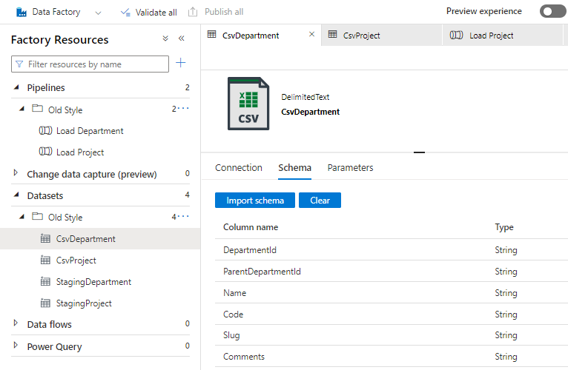
ADF Approach (like SSIS)
Lots of datasets
Lots of pipelines
With schema defined
Column changes requires updating dataset schema
Redeployment (in different environments)

Slide 13
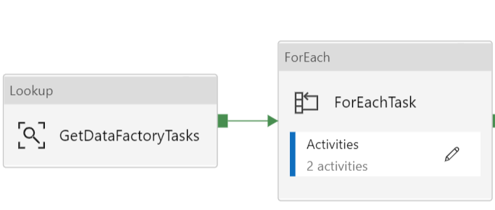
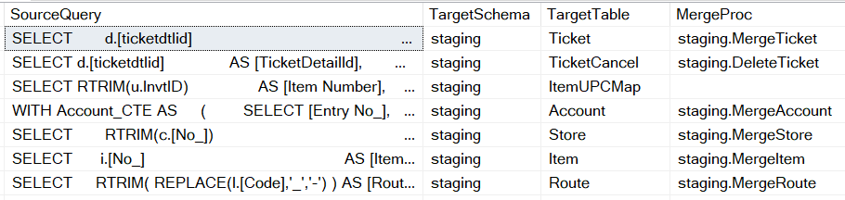
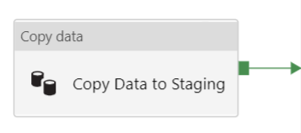
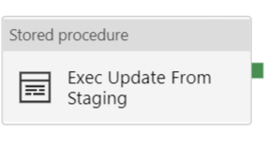
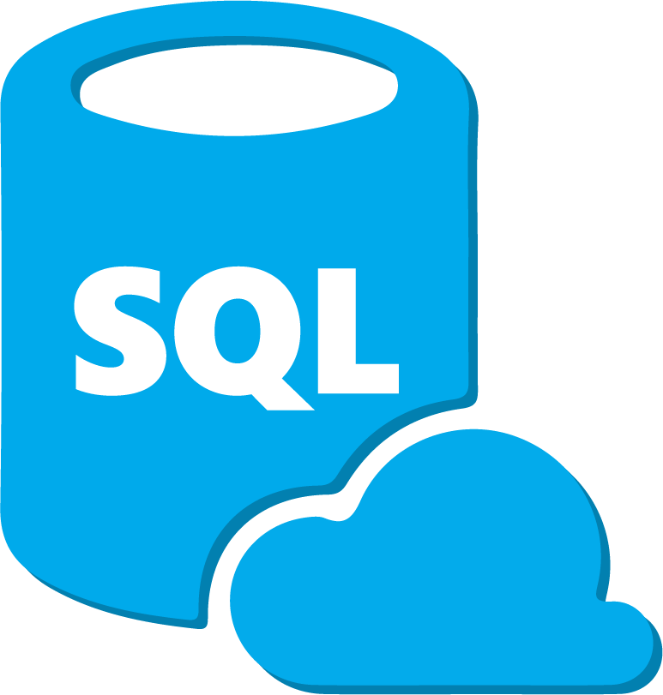
Typical Metadata-driven Pipeline Pattern
Azure Data Factory
Exec ETL.GetDataFactoryTasks
Data Warehouse

Slide 14
Advantages of Metadata-driven Approach
ETL Change | SSIS | Deploy SSIS? | ADF | Deploy ADF?
New data from new source | New data connection, new package or dataflow, | Yes | New service connection, new dataset, new pipeline | Yes
New data from existing source | New package or dataflow | Yes | Add task metadata | No
Add/change/drop column in existing source | Refresh column metadata in source & target | Yes | Update task metadata, update target (sometimes) | No
Change dependency | Update package | Yes | Update task metadata, update pipeline (sometimes) | Sometimes
Stop loading existing data | Remove or disable package | Yes | Remove task | No

Slide 15
ADF: Typical Pipeline (per data source type)
Lookup task
Executes a query on target to get a list of tasks
JSON output
For Each Task
Copy Data Task
Execute Stored Procedure Task

Slide 16
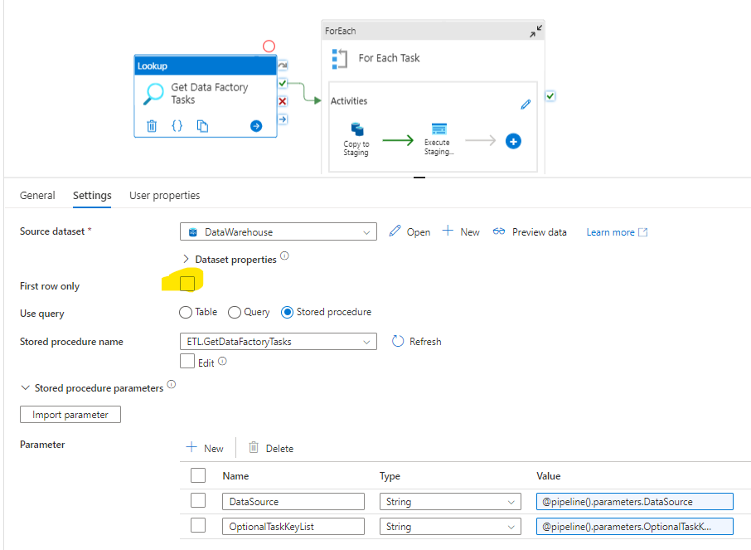
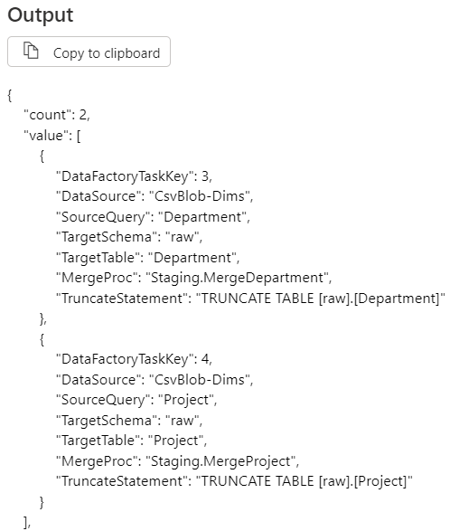
ADF: Lookup Task
Execute Stored Procedure
ETL.GetDataFactoryTasks @DataSource
(Clear First Row Only)
Result is a JSON document
(Can also use JSON files for Lookup)

Slide 17
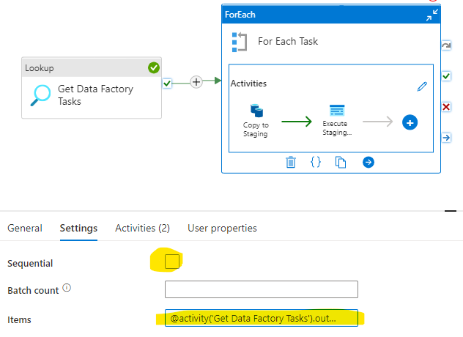
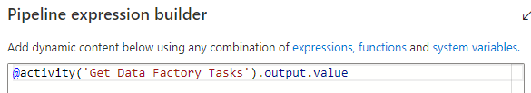
ADF: For Each Task
For Each task
Iterates through a collection (output of Lookup)
Item() object
Parallel or Serial execution

Slide 18
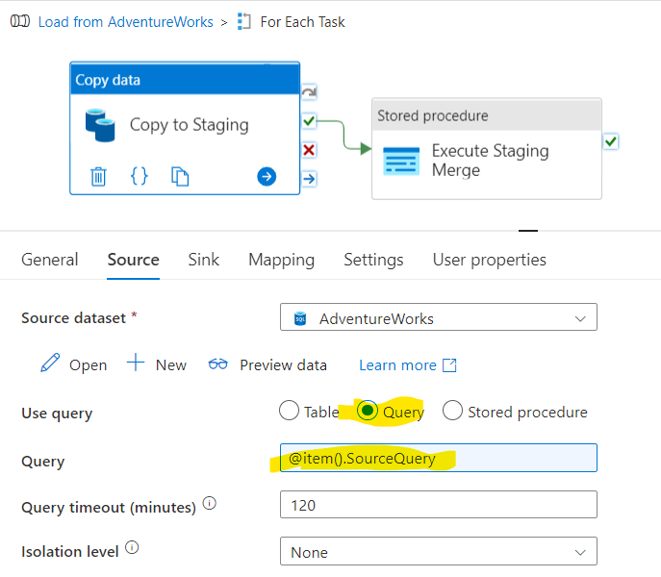
ADF: For Each – Copy Data Task
Source: Links to Dataset (linked to a service like SQL Server, File System → text, CSV, Excel, other, Data Lake)
Dynamic property for Source Query

Slide 19
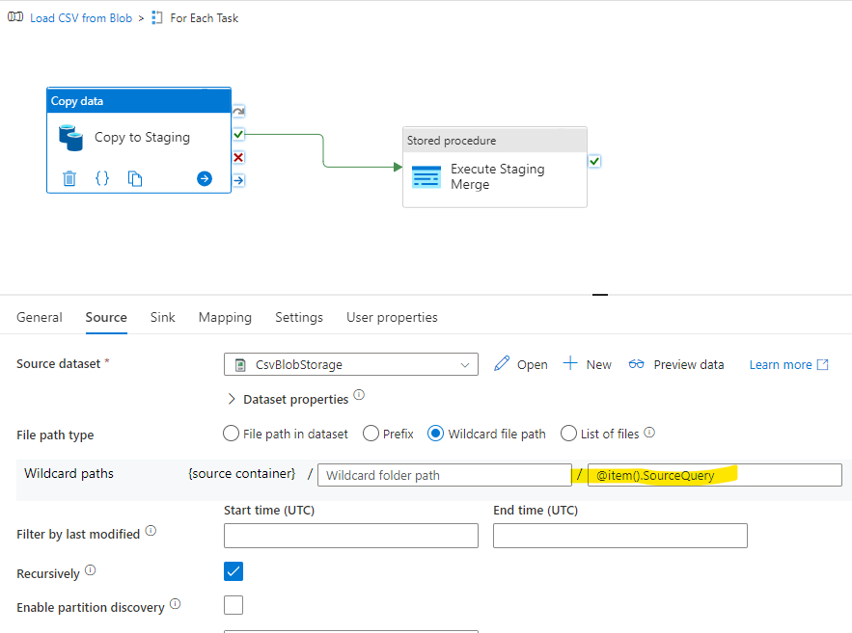
ADF: For Each – Copy Data Task
Source: Links to Dataset (linked to a service like SQL Server, File System → text, CSV, Excel, other, Data Lake)
Dynamic property for Source Query

Slide 20
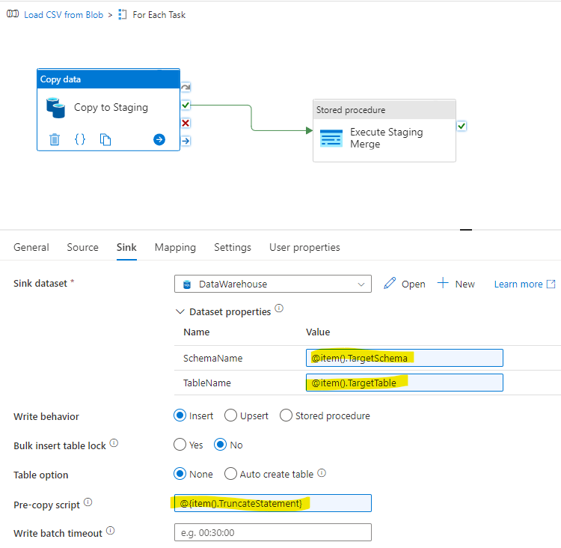
ADF: For Each – Copy Data Task
Sink: links to target Dataset, with parameters for schema and table
Dynamic properties for Target Schema & Table, Pre-copy script
Use pre-copy script to clear staging table

Slide 21
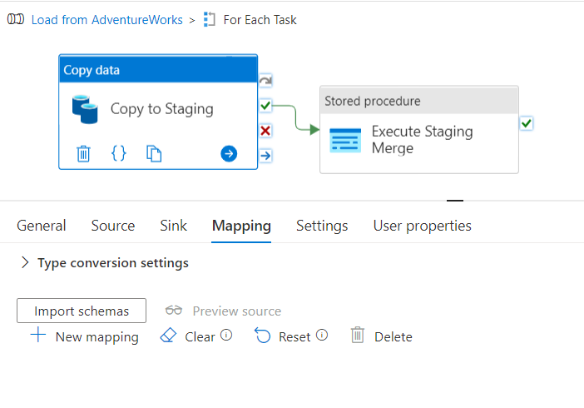
ADF: For Each – Copy Data Task
Optional column mapping (very different from SSIS)
No column mapping
case-sensitive name matching
all source columns must exist in target
not all target columns must be mapped

Slide 22
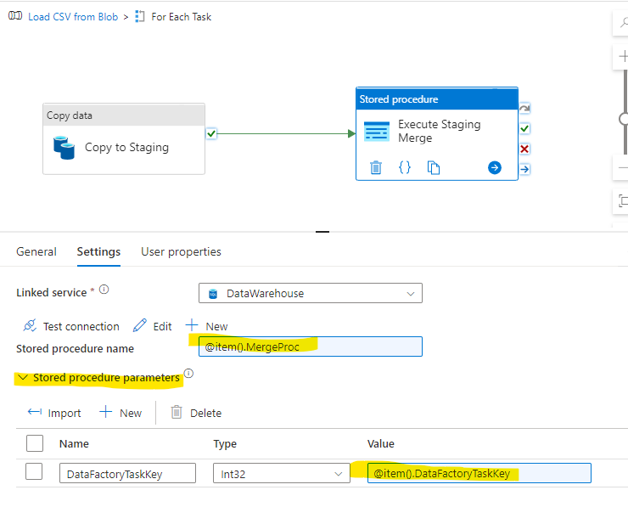
ADF: For Each – Execute Stored Proc Task
Call Stored Procedure on Target to process staging data
Can have parameters but they must all be the same signature

Slide 23
How Many ADF Datasets?
As few as possible
Do not define schema (column names and types)
At least one Dataset per linked service and result type
SQL Server, Oracle, MySQL, PostGreSQL, Snowflake, etc
Can have parameters for server and database (advanced)
Files (by type and location)
Excel on SharePoint
Excel on File System
CSV on SharePoint, etc
CSV on Azure Data Lake Storage
Often require parameters for folder, path, and file wildcards

Slide 24
How Many ADF Pipelines?
Usually One per Source Dataset, plus one Main pipeline
Most pipelines use the Lookup/ForEach/Copy Data/Exec Sproc pattern
Pipeline Parameter for Lookup Task
Exec ETL.GetFactoryTasks @DataSource
ADF Debug support:
OptionalTaskKeyList pipeline parameter, defaults to “All”
Value is parsed in the ETL.GetFactoryTasks sproc to limit tasks

Slide 25
Main Pipeline
Calls Task-driven pipelines with parameter for selecting tasks
Main pipeline handles dependencies
“Level 1” pipelines – loading dimensions
“Level 2” pipelines – loading facts (which depend on dimensions)
Additional levels as needed, based on dependency tree
Advanced: Main pipeline can use the Lookup/ForEach pattern to get a list of pipelines (and their parameters) to execute

Slide 26
ETL.DataFactoryTask table
DataFactory TaskKey | DataSource | Target Schema | Target Table | MergeProc | SourceQuery | Incremental Date | LastCopied | Ordinal
3 | CsvBlob-Dims | raw | Department | Staging.MergeDepartment | Department.csv |  |  | 1
4 | CsvBlob-Dims | raw | Project | Staging.MergeProject | Project.csv |  |  | 1
5 | AdventureWorks-Dims | Staging | Product | Staging.MergeProduct | Select * from Products |  |  | 1

Slide 27
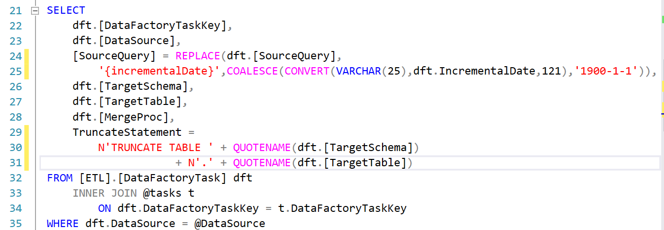
ETL.GetDataFactoryTasks Procedure
@DataSource –named set of tasks
@OptionalTaskKeyList – comma-separated list of task numbers (or “All”)
Selects rows from ETL.DataFactoryTask table
Does REPLACE on tokens in SouceQuery

Slide 28
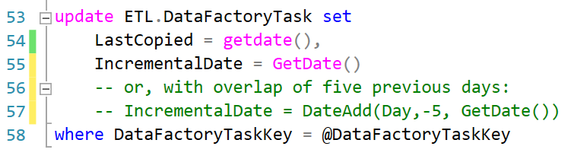
Staging.MergeCustomer Procedure
Data Warehouse dimension example
Merges from Staging.Customer to dw.Customer
Handles slowly-changing attributes
Updates ETL.DataFactoryTask table
LastExecutionDate
(sometimes IncrementalDate)

Slide 29
Handling Incremental Loading
ETL.GetDataFactoryTasks
DataFactoryTask.IncrementalDate column
DataFactoryTask.SourceQuery {IncrementalDate} token replacement
Staging.MergeSales
Updates DataFactoryTask.IncrementalDate column
Need a full reload?
Reset DataFactoryTask.IncrementalDate column (manually)

Slide 30
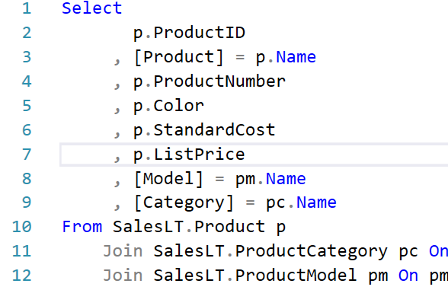
Transform as early as possible*
Data Sources that support a query language (SQL)
DataFactoryTask.SourceQuery contains query to execute on source
Query should return column names based on Staging table (how you want them)
Query should cast source data to correct datatypes
Target schema: Staging
Target table: Customer, Store, etc
*Roche’s Maxim of Data Transformation: https://ssbipolar.com/2021/05/31/roches-maxim/
Data should be transformed as far upstream as possible, and as far downstream as necessary.

Slide 31
Transform as early as possible*
Data Sources that do not support a query language (files)
Target table in raw schema, not in Staging schema
Use “auto-create table” once in ADF to have the table created the first time
Most auto-created tables have varchar(255) or varchar(max) columns
Adjust size as you wish, but be cautious about changing from strings
Create a view in Staging that does the transformation and naming and data type casting
Can combine multiple raw tables into one Staging view, one Staging procedure
REST API source data
Behave similar to Files
Often use utility to call REST API and save JSON to Azure Blob Storage
* Roche’s Maxim of Data Transformation: https://ssbipolar.com/2021/05/31/roches-maxim/
Data should be transformed as far upstream as possible, and as far downstream as necessary.

Slide 32
Populating ETL.DataFactoryTask table
BackfillFactoryTasks SQL script
SQL Database Project post-deployment script

Slide 33
Demo

Slide 34
Changing ETL Requirements
New table in target from same source?
Add Staging and dw tables, Staging Merge Procedure
Add a row to DataFactoryTask table
No ADF changes required
Change in target table? (Add column, remove column, change column)
Change Staging and dw tables, Staging Merge Procedure
Update row in DataFactoryTask SourceQuery
Incorrect logic in SourceQuery?
Update DataFactoryTask row
Target table no longer needed?
Remove row from DataFactoryTask

Slide 35
Advantages of Metadata-driven Approach
ETL Change | SSIS | Deploy SSIS? | ADF | Deploy ADF?
New data from new source | New data connection, new package or dataflow, | Yes | New service connection, new dataset, new pipeline | Yes
New data from existing source | New package or dataflow | Yes | Add task metadata | No
Add/change/drop column in existing source | Refresh column metadata in source & target | Yes | Update task metadata, update target (sometimes) | No
Change dependency | Update package | Yes | Update task metadata, update pipeline (sometimes) | Sometimes
Stop loading existing data | Remove or disable package | Yes | Remove task | No

Slide 36
Questions?
Session Evaluation
Code and slides:
https://github.com/xhead/SqlSaturdayATL
Mike Diehl, Miked@imaginet.Com
Practice Lead
Data Engineering and Business Intelligence
@xhead
/mikediehlsqlbi

